Slide 1
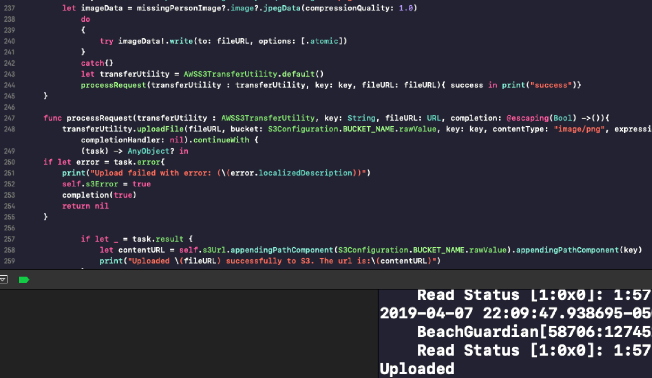
Edward – Week 10 (1) Completed Tasks
Completed Tasks
Increased code coverage
S3 refactored
Not using AWSTransferManager because of massive warning amounts (use of AWSTransferManager is also deprecated)
Using Cognito with S3

Slide 2
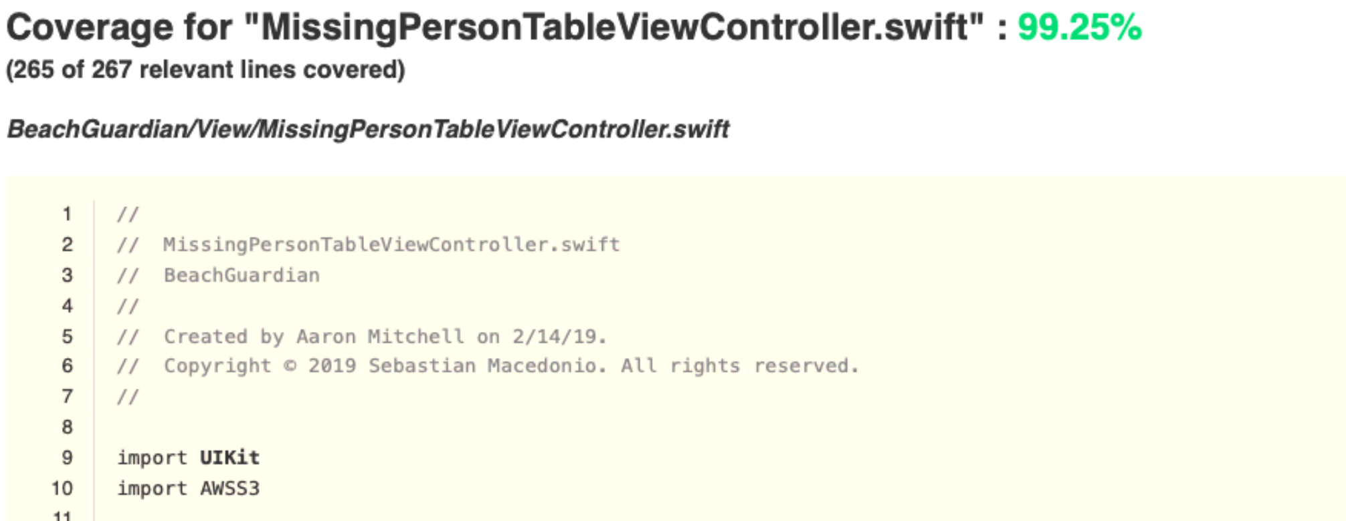
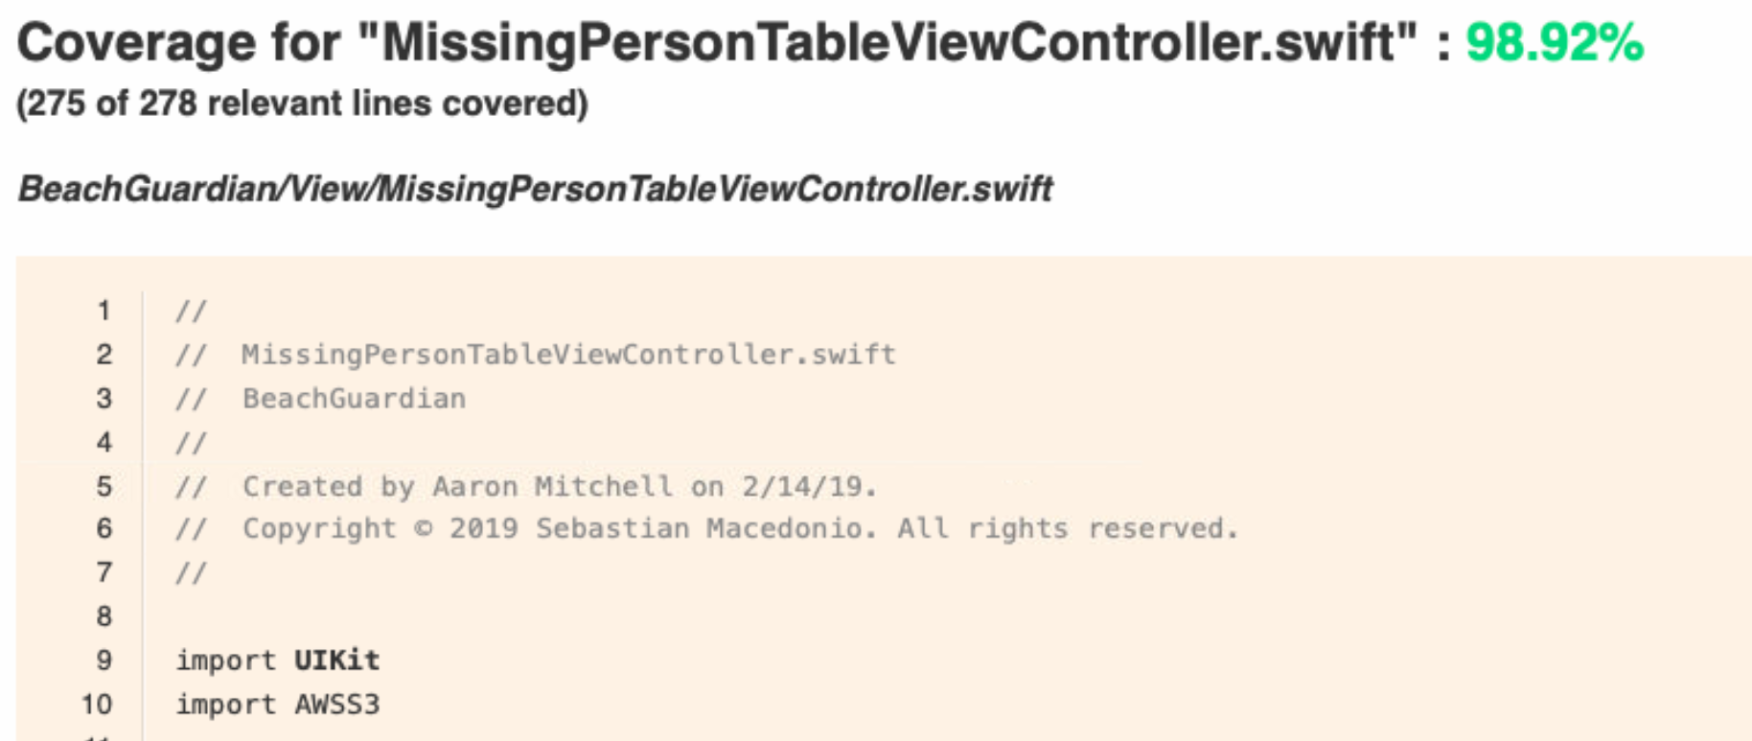
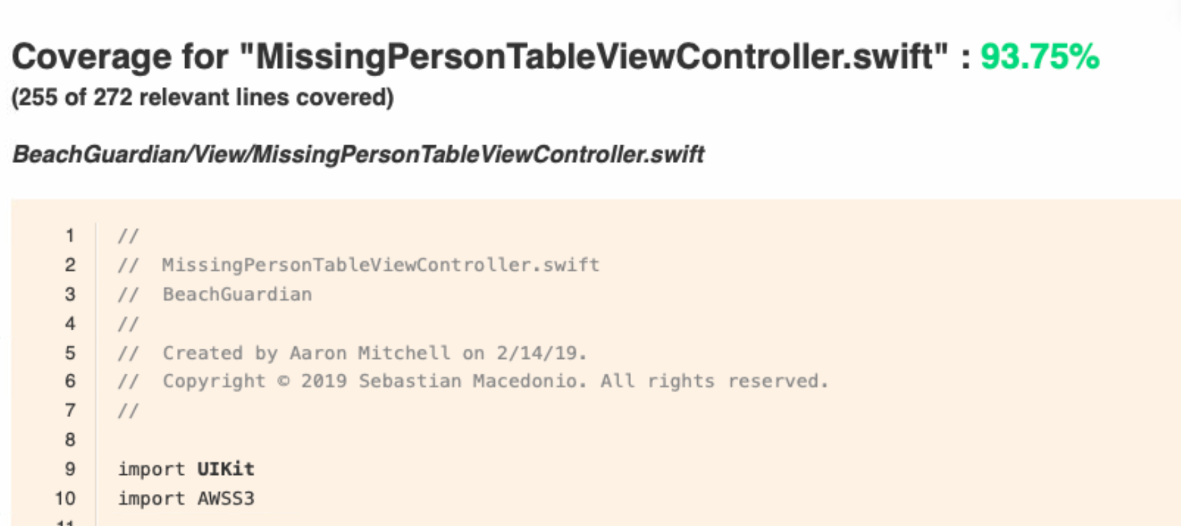
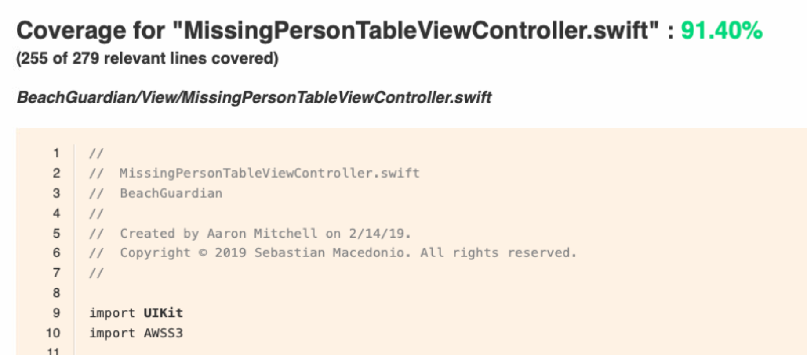
Edward – Week 10 (2) Completed Tasks
All warnings removed related to S3 in Missing Form Page due to:
Minor cleanup of code
Refactoring of tests
Removal of deprecated AWSTransferManager class usage
Testing for S3 code at 95%+

Slide 3
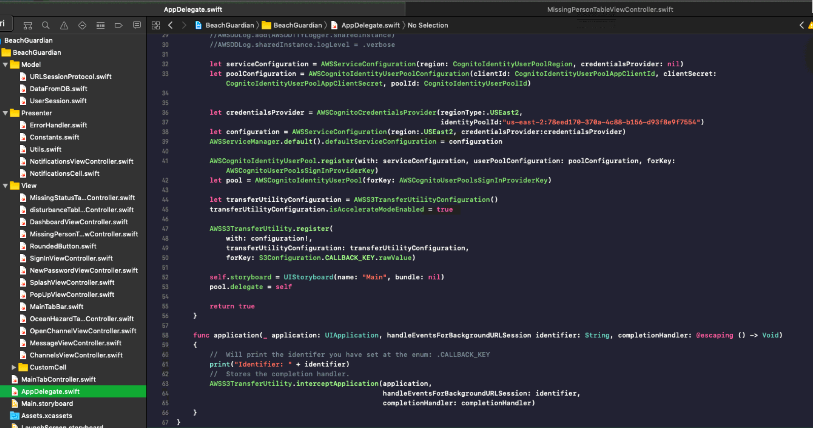
Edward Lie – Week 10 (3) In Progress Tasks
My week 11 goal is implement S3 in other forms. Wherever tests are not at 100%, I will be looking to improve.
I also look to remedy UI and action hookup issues

